Slide 1

Jonnie Muench
CS-377A
Database Design

Slide 2
Database Purpose
Sim Advisor is a racing simulator counselling, building, and upgrading service.
The database stores customers, products, services, orders, and appointments.
The database is used to take orders from customers, update the status of orders as they are worked on, and track order history.

Slide 3
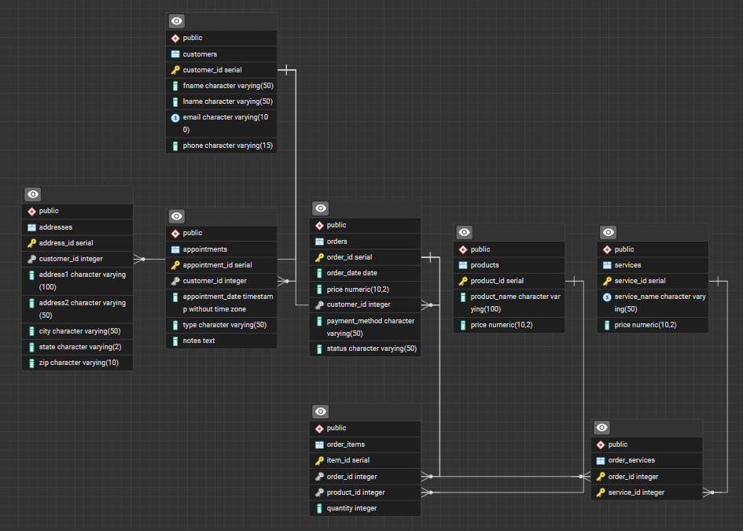
ERD

Slide 4
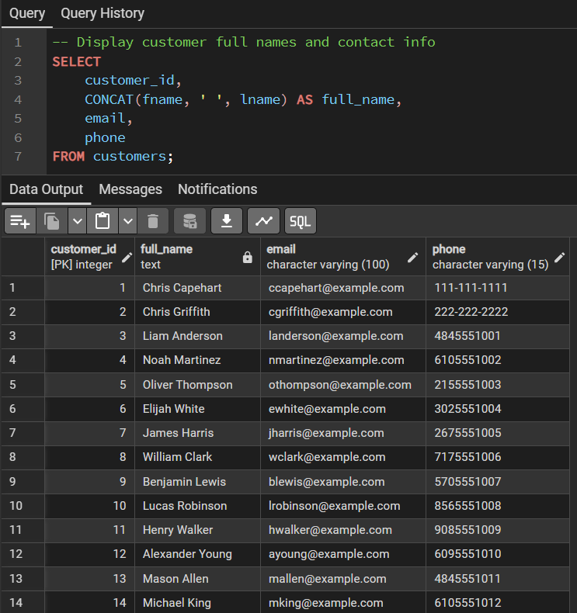
Customers

Slide 5
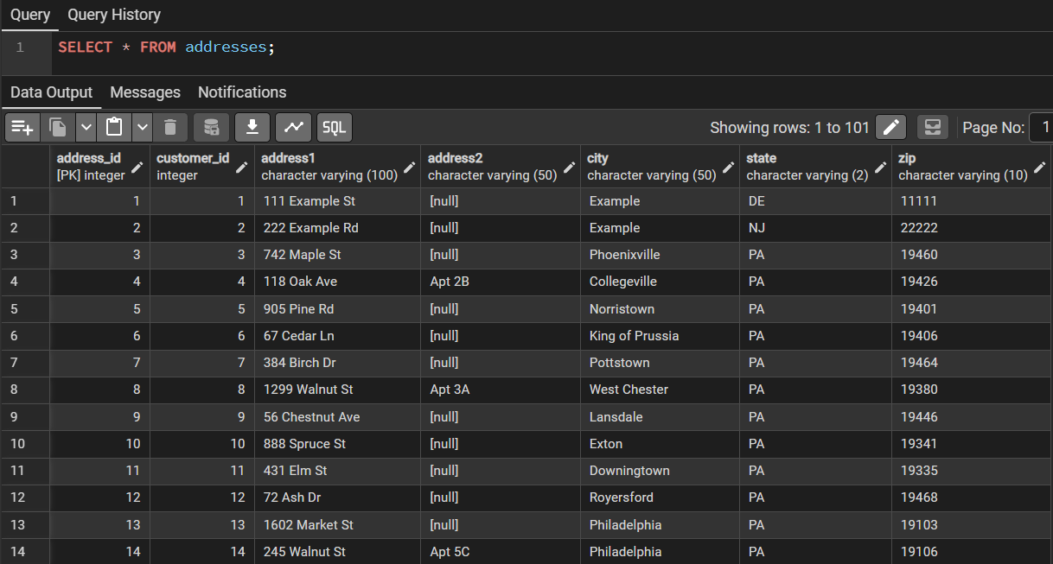
Addresses

Slide 6
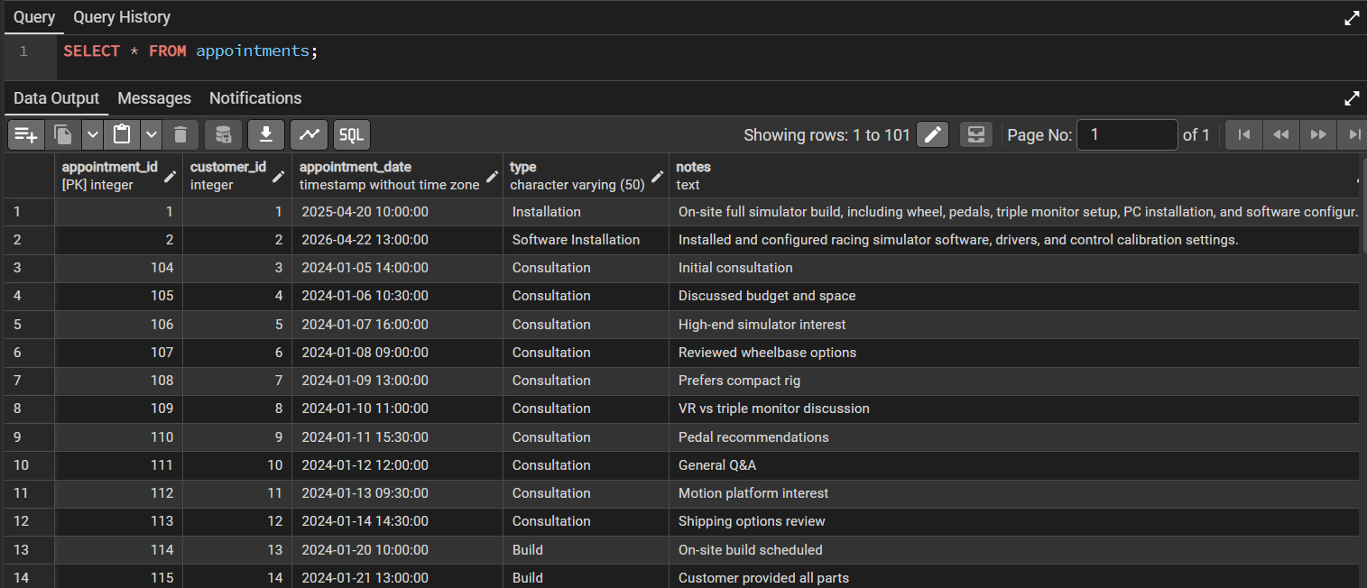
Appointments

Slide 7
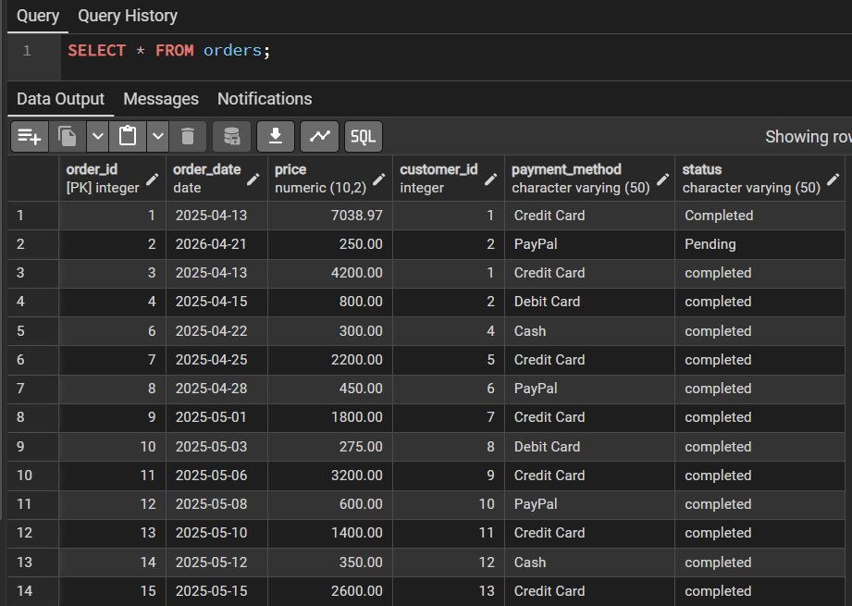
Orders

Slide 8
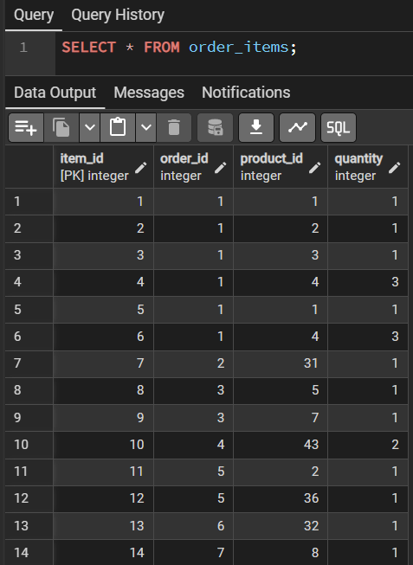
Order Items

Slide 9
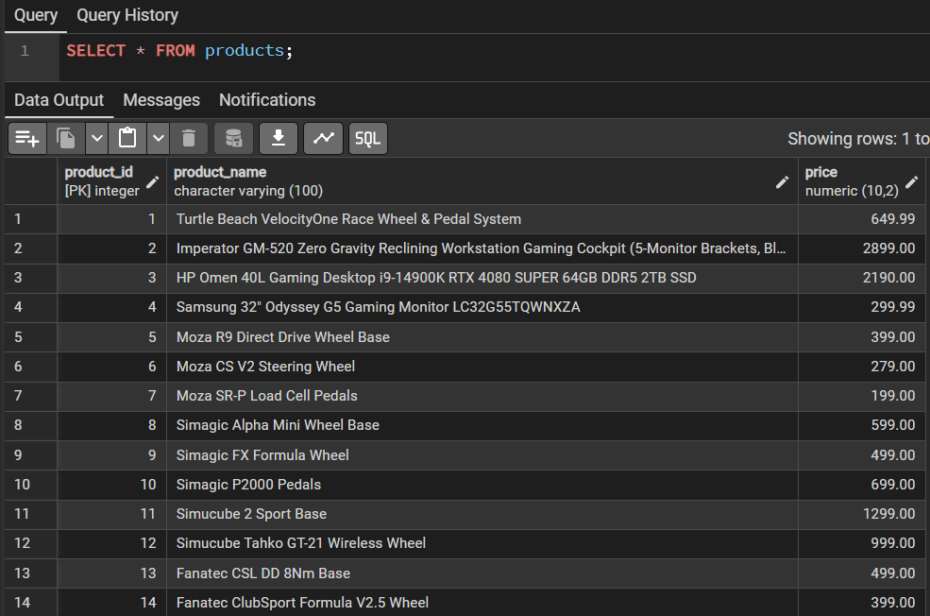
Products

Slide 10
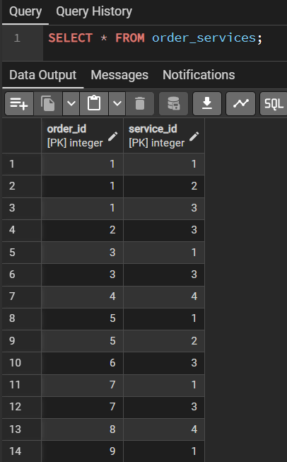
Order Services

Slide 11
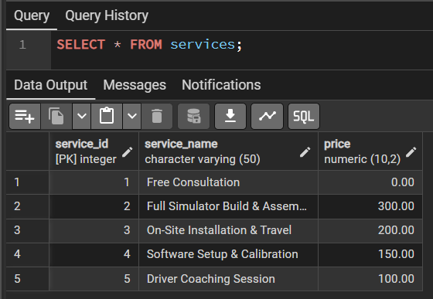
Services

